Slide 1
Serverless
Bingxuan Ying (AWS) / Mesh (GCP)

Slide 2
Serverless Quick intro
Serverless is a cloud-native development model that allows developers to build and run applications without having to manage servers.
There are still servers in serverless, but they are abstracted away from app development. A cloud provider handles the routine work of provisioning, maintaining, and scaling the server infrastructure. Developers can simply package their code in containers for deployment.
Once deployed, serverless apps respond to demand and automatically scale up and down as needed. Serverless offerings from public cloud providers are usually metered on-demand through an event-driven execution model. As a result, when a serverless function is sitting idle, it doesn’t cost anything.

Slide 3
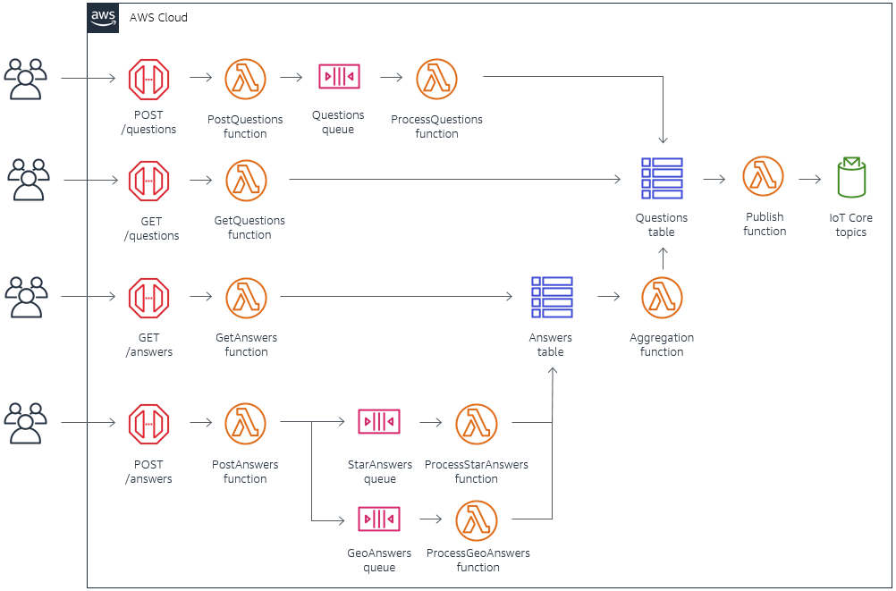
Platforms
AWS
GCP

Slide 4
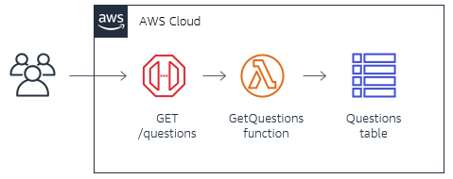
TEST loads
GET
AWS
GCP
POST

Slide 5
AWS Lambda service
Bingxuan Yig

Slide 6
Intro
Run code without provisioning or managing infrastructure. Simply write and upload code as a .zip file or container image.
Automatically respond to code execution requests at any scale, from a dozen events per day to hundreds of thousands per second.
Save costs by paying only for the compute time you use—by per-millisecond—instead of provisioning infrastructure upfront for peak capacity.
Optimize code execution time and performance with the right function memory size. Respond to high demand in double-digit milliseconds with Provisioned Concurrency.
AWS Lambda is a serverless, event-driven compute service that lets you run code for virtually any type of application or backend service without provisioning or managing servers. You can trigger Lambda from over 200 AWS services and software as a service (SaaS) applications, and only pay for what you use.

Slide 7
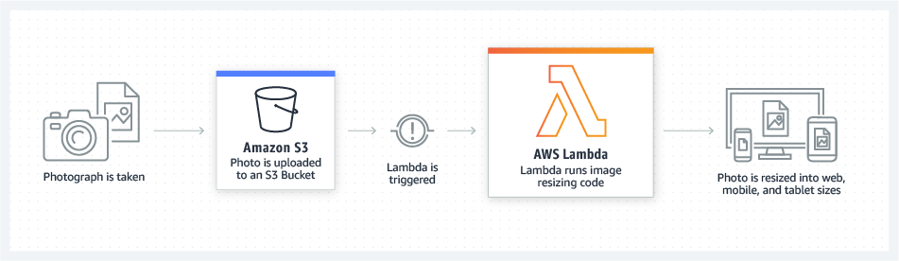
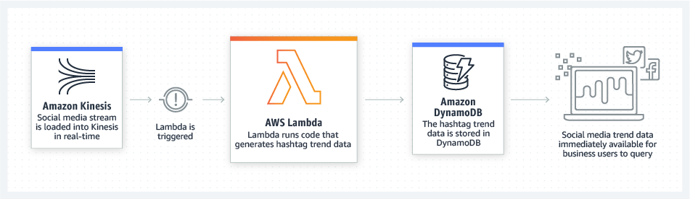
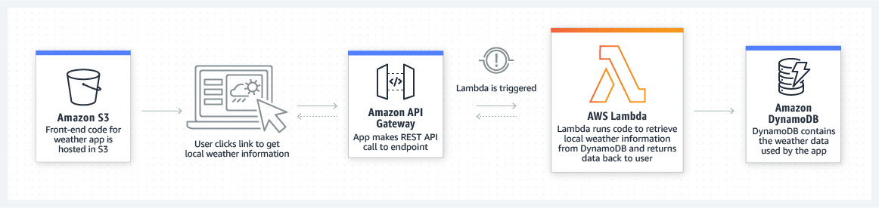
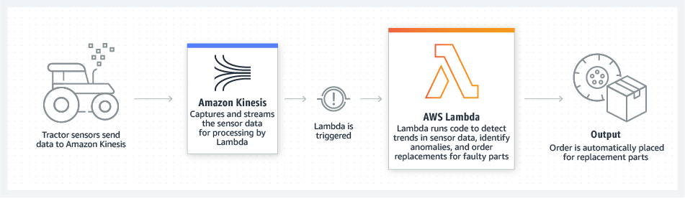
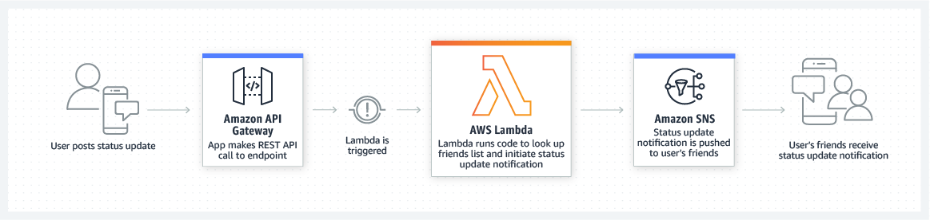
Scenarios
File processing
Stream processing
Web applications
IoT backends
Mobile backends

Slide 8
Special about naws
Handle extra concurrency request >4000.
Handle extra file size > 15Mb.
NAWS stands for Native AWS

Slide 9
Tests
Send incrementing number of request to lambda.
Use both GET, POST
Store file in Aurora RDS
Send request on Cloud9
Calculate min, median, max time it takes.
Load Test

